Slide 1

Sprocket Central Pty Ltd
Data analytics approach
Anand Kumar Singh – Data Analyst

Slide 2
Agenda
Introduction
Data Exploration
Model Development
Interpretation

Slide 3
Introduction
Identify and Recommend Top 1000 Customer to Target from Datasets
Problem Outline
Sprocket Central is a company specializing in premium bikes and cycling accessories.
Their marketing team wants to increase business sales by analyzing provided datasets.
The goal is to analyze the datasets and identify 1000 customers that Sprocket Central should target to maximize company value.
The analysis will involve three phases: Data Exploration, Model Development, and Interpretation.
Contents of Data Analysis
“New” vs “Old” Customer Age Distribution.
Bike related purchases over the last 3 years by gender
Job industry distributions
Wealth segmentation by age category
Number of cars owned and not owned by state
RFM analysis and customer classification

Slide 4
Data Exploration
Data Quality Assessment and ‘Clean Up’
Column name | Accuracy | Completeness | Consistency | Currency | Relevancy | Validity
Customer Demographics | DOB: Inaccurate Age: missing | Job Title: Blanks Customer id: Blanks | Gender: Inconsistent | Deceased customers: filtered out | Default column: Delete
Customer Address |  | Customer id: Incomplete | States: Inconsistent
Transactions | Profit: Missing | Customer id: Incomplete Online orders: Blanks Brands: Blanks |  |  | Cancelled status order: Filtered out | List Price: Format Product sold date: Format

Slide 5
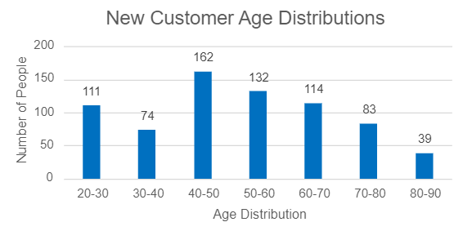
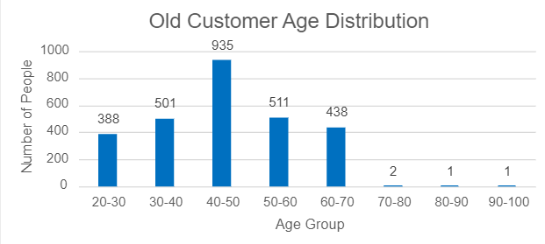
Data Exploration
‘New’ vs ‘Old’ Customer Age Distribution
The majority of customers in the "New" category are between the ages of 40-50. Similarly, "Old" category also fall within the 40-50 age range.
The lowest age groups in both categories are 80 years and above.
The ‘New’ customers list indicates that most populated age groups are 20-30 and 40-67.
The ‘Old’ customer list suggests 20-60
Notably, there is a significant decline in the number of customers in the 30-40 age group within the "New" category.

Slide 6
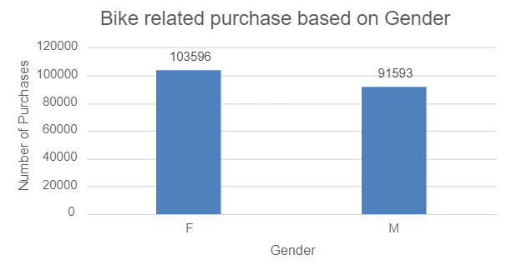
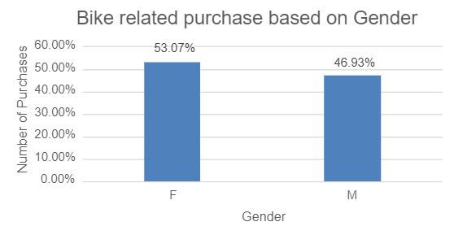
Data Exploration
Bike related Purchases Over the Last 3 Years Based On Gender
According to the data, females have made a higher average number of bike-related purchases in the past three years compared to males.
Females accounted for 53% of bike-related purchases, while men made up 47% of the purchases..
In the past three years, females have, on average, recorded 7% higher bike-related purchases compared to men.

Slide 7
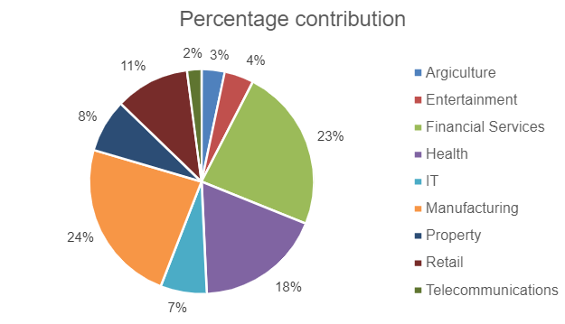
Data Exploration
Job Industry Distribution based on Profit
The three industry sectors generating the highest profits are Manufacturing (24%), Financial Services (23%), and Health (18%).
Agriculture (3%) and Telecommunications (2%) have the smallest customer base.
This trend is expected since many of these industry sectors are situated in or near urban areas, making bikes a preferred mode of transportation for commuting.

Slide 8
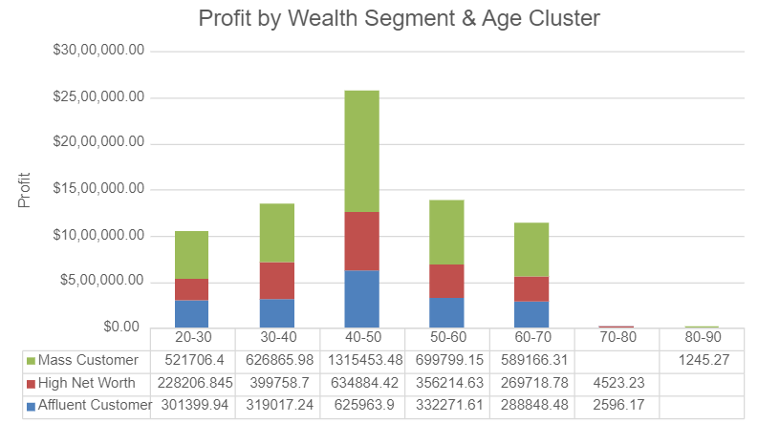
Data Exploration
Profit by Wealth Segment & Age Cluster
In general, the mass customer segment generates the highest profit across various age clusters.
Among different age clusters, the mass customers aged between 40-50 are more likely to contribute higher profits to the company.
This observation also suggests a trend in buying power, where purchasing capacity tends to increase until the age of 50 and then gradually declines, resulting in lower profits.

Slide 9
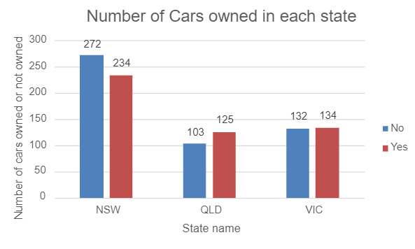
Data Exploration
Number of Cars Owned in each state
The state of NSW has the highest proportion of individuals who do not own a car. It appears that a larger sample size was collected from NSW compared to other regions, if not, then NSW must be targeted as it shows a highest potential.
Victoria, on the other hand, shows a relatively even distribution, although the number of individuals without car ownership is notably lower than in NSW.
QLD exhibits a relatively higher number of customers who own a car compared to other states.

Slide 10
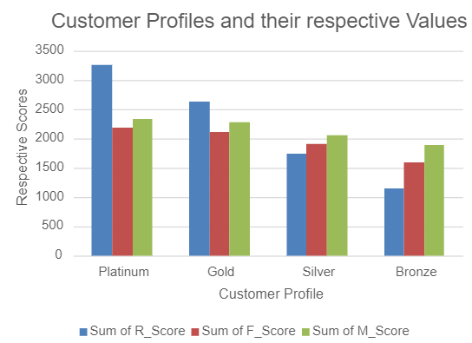
Model Development
RFM Analysis and Customer Classification
The RFM analysis is utilized to identify the customers a business should prioritize in order to enhance revenue and value.
By utilizing the RFM (Recency, Frequency, and Monetary) model, customers who have demonstrated significant engagement across these three categories (in terms of Recency/Frequency/Profits) can be identified as shown in the Graph.
We have assigned greater importance to Recency, as it has been observed that the most recent customers actually contribute the highest revenue. (Customer retention is also a crucial aspect that we considered.)

Slide 11
Model Development
Customer Classification – Targeting High Value Customers
The high value customers that should be targeted from the new list must have following attribute:
High RFM Score
Working in the financial services, health and manufacturing industry sector.
Aged between 30-50.
Who are currently living in NSW, VIC.

Slide 12
Interpretation
Summary Table for High Value Customer
Please see below the list of some valuable customers
First Name | Bike related purchases over the last 3 Year | Age | Job Industry | Wealth Segment | Owns Cars | State | RFM Value
Cary | 76 | 39 | Manufacturing | Mass Customer | No | NSW | 444
Verla | 61 | 45 | Health | Mass Customer | Yes | NSW | 444
Mayor | 51 | 49 | Manufacturing | Mass Customer | No | NSW | 444
Heinrik | 7 | 48 | Financial Services | Mass Customer | Yes | NSW | 444
Efren | 64 | 48 | Financial Services | Mass Customer | No | NSW | 444
Hakim | 18 | 43 | Financial Services | Mass Customer | Yes | NSW | 444
Annis | 78 | 34 | Manufacturing | Mass Customer | Yes | VIC | 444

Slide 13
Interpretation
Summary Table for new Target Customers
Please see below the list of some High potential revenue yielding Customers
First Name | Bike related purchases over the last 3 Year | Age | Job Industry | Wealth Segment | Owns Cars | State
Rutledge | 23 | 47 | Financial Services | Mass Customer | No | NSW
Melba | 38 | 47 | Health | Mass Customer | No | NSW
Winnifred | 83 | 47 | Financial Services | Mass Customer | No | VIC
Sybilla | 88 | 36 | Financial Services | Mass Customer | Yes | NSW
Colene | 24 | 38 | Financial Services | Mass Customer | No | VIC
Gale | 59 | 46 | Financial Services | Mass Customer | Yes | VIC
Martelle | 52 | 42 | Manufacturing | Mass Customer | No | NSW

Slide 14
Thank You

